Slide 1
Expected vs. Unexpected Behaviors

Slide 2
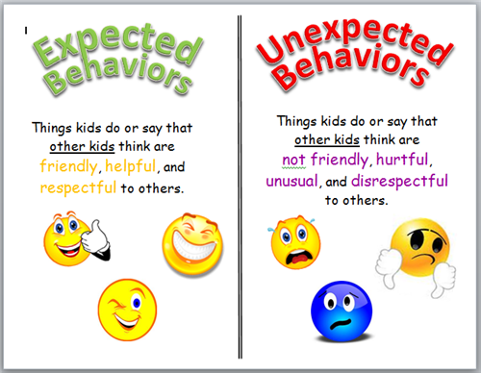
What are they?

Slide 3
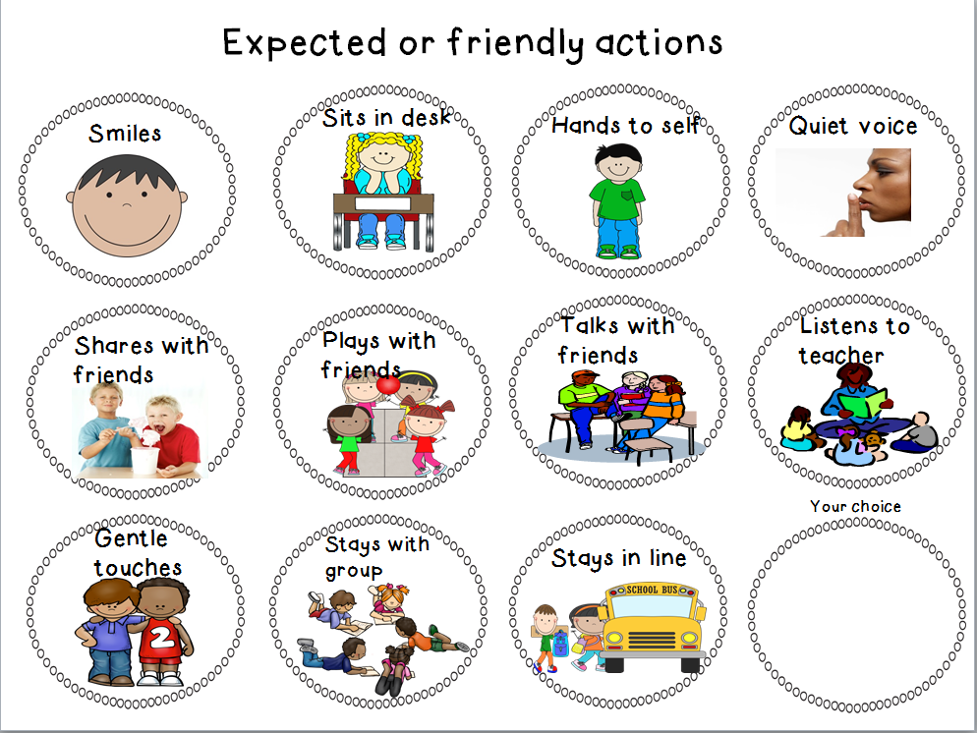
What do Expected Behaviors Look Like?

Slide 4
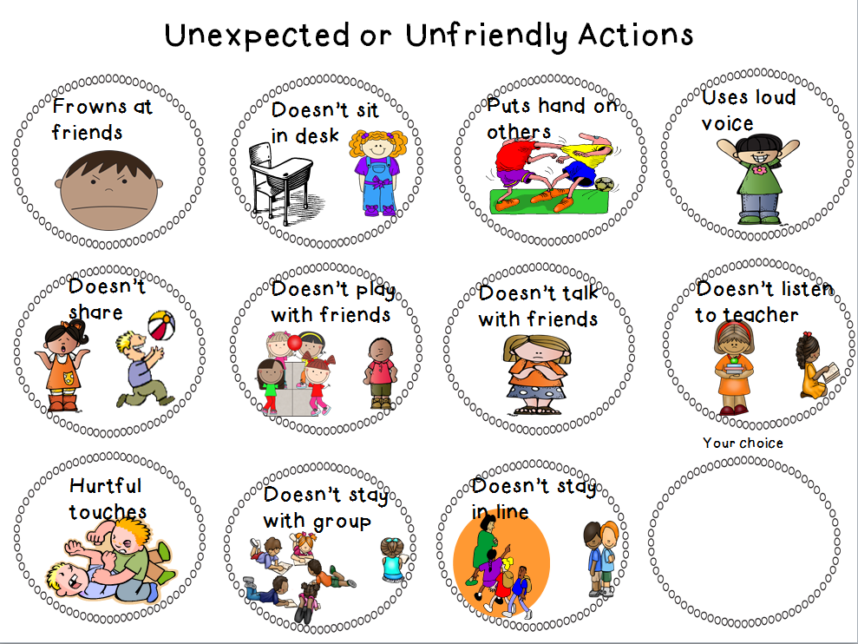
What do Unexpected Behaviors look like?

Slide 5
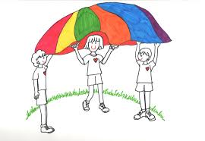
Let’s play the Expected vs. Unexpected Picture Game!
Is this behavior Expected or Unexpected?
How can you tell?

Slide 6

Expected vs. Unexpected
Is this behavior Expected or Unexpected?
How can you tell?

Slide 7

Expected vs. Unexpected
Is this behavior Expected or Unexpected?
How can you tell?

Slide 8

Expected vs. Unexpected
Is this behavior Expected or Unexpected?
How can you tell?

Slide 9
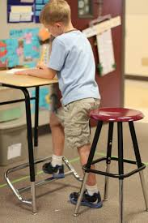
Expected vs. Unexpected
Is this behavior Expected or Unexpected?
How can you tell?

Slide 10
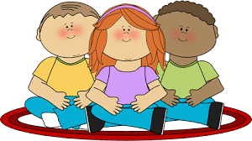
Expected vs. Unexpected
Is this behavior Expected or Unexpected?
How can you tell?

Slide 11
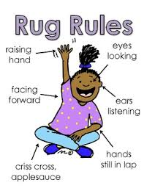
Expected vs. Unexpected
Is this behavior Expected or Unexpected?
How can you tell?

Slide 12
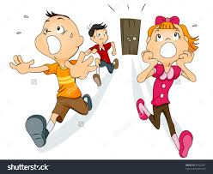
Expected vs. Unexpected
Is this behavior Expected or Unexpected?
How can you tell?

Slide 13
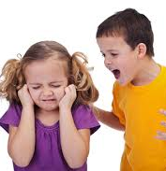
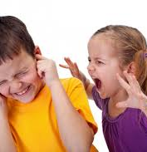
Expected or Unexpected ?
How can you tell?

Slide 14
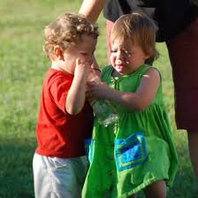
Expected vs. Unexpected
Is this behavior Expected or Unexpected?
How can you tell?

Slide 15
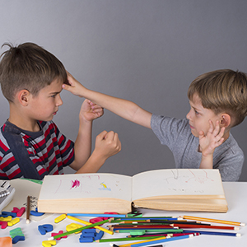
Expected vs. Unexpected
Is this behavior Expected or Unexpected?
How can you tell?

Slide 16
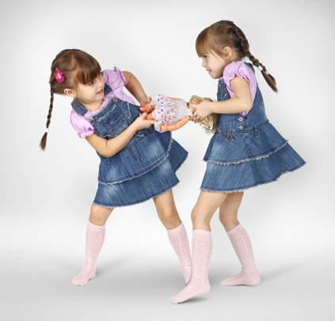
Expected vs. Unexpected
Is this behavior Expected or Unexpected?
How can you tell?

Slide 17
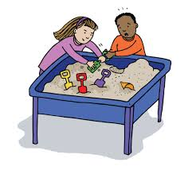
Expected vs. Unexpected
Is this behavior Expected or Unexpected?
How can you tell?

Slide 18
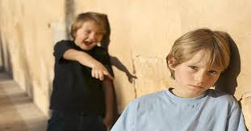
Expected vs. Unexpected
Is this behavior Expected or Unexpected?
How can you tell?

Slide 19
Why do Expected Behaviors help us make lots of friends?

Slide 20
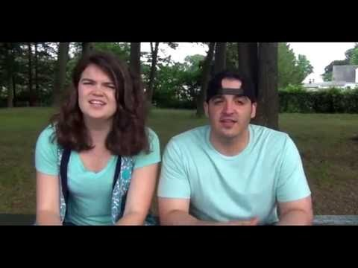
How do Expected Behaviors and Superflex go together?
Let’s watch a video!
“Superflexin” Helps You Make Lots of Friends

Slide 21

Superflexin YOU!
Look in the mirror and insert your picture here.

